Slide 1
CSS Margin

Slide 2
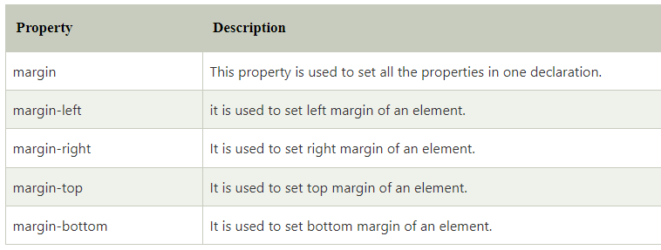
CSS Margin property is used to define the space around elements. It is completely transparent and doesn't have any background color. It clears an area around the element.
Top, bottom, left and right margin can be changed independently using separate properties. You can also change all properties at once by using shorthand margin property.
There are following CSS margin properties:
CSS Margin Properties

Slide 3
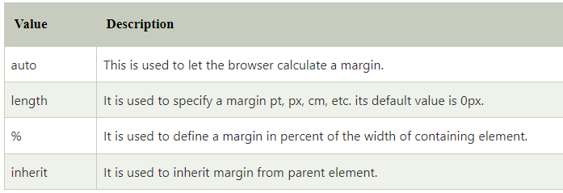
CSS Margin Values
These are some possible values for margin property.
CSS margin Example
<style>
p {
background-color: pink;
}
p.ex {
margin-top: 50px;
margin-bottom: 50px;
margin-right: 100px;
margin-left: 100px;
}
</style>
<body>
<p>This paragraph is not displayed with specified margin. </p>
<p class="ex">This paragraph is displayed with specified margin.</p>
</body>

Slide 4
CSS Opacity
The CSS opacity property is used to specify the transparency of an element. In simple word, you can say that it specifies the clarity of the image.
How to apply CSS opacity setting
Opacity setting is applied uniformly across the entire object and the opacity value is defined in term of digital value less than 1. The lesser opacity value displays the greater opacity.
Example :
<style>
img.trans {
opacity: 0.4;
filter: alpha(opacity=40); /* For IE8 and earlier */
}
</style>
<body>
<p>Normal Image</p>
<img src="rose.jpg" alt="normal rose">
<p>Transparent Image</p>
<img class="trans" src="rose.jpg" alt="transparent rose">
</body>

Slide 5
CSS Images
Images are an important part of any web application. Including a lot of images in a web application is generally not recommended, but it is important to use the images wherever they required. CSS helps us to control the display of images in web applications.
The styling of an image in CSS is similar to the styling of an element by using the borders and margins. There are multiple CSS properties such as border property, height property, width property, etc. that helps us to style an image.
Transparent image
<style>
img{
border: 2px solid red;
border-radius:5px;
padding:10px;
opacity:0.3;
} </style>
<body>
<h1>Transparent Image</h1>
<img src="jtp.png"></img>
<h2>Welcome to javaTpoint</h2>
</body>

Slide 6
Rounded image
The border-radius property sets the radius of the bordered image. It is used to create the rounded images.
#img1{
border: 2px solid green;
border-radius:10px;
padding:5px;
}
#img2{
border: 2px solid green;
border-radius:50%;
padding:5px;
}
<body>
<img src="jtp.png" id="img1"></img>
<img src="jtp.png" id="img2"></img>
</body>

Slide 7
Responsive Image
It automatically adjusts to fit on the screen size. It is used to adjust the image to the specified box automatically.
<style>
#img1{
max-width:100%;
height:auto;
} </style>
<body>
<h1>Responsive image</h1>
<h2>You can resize the browser to see the effect</h2>
<img src="jtp.png" id="img1" width="1000" height="300"></img>
</body>

Slide 8
Center an Image
We can center an image by using the left-margin and right-margin property. We have to set these properties to auto in order to make a block element.
<style>
#img1{
margin-left:auto;
margin-right:auto;
display:block;
} </style>
<body>
<h1>Center image</h1>
<img src="jtp.png" id="img1"></img>
</body>

Slide 9
CSS Overflow
The CSS overflow property specifies how to handle the content when it overflows its block level container.
Let's take an example: If you don't set the height of the box, it will grow as large as the content. But if you set a specific height or width of the box and the content inside cannot fit then what will happen. The CSS overflow property is used to overcome this problem. It specifies whether to clip content, render scroll bars, or just display content.
<style>
div.scroll {
background-color: #00ffff;
width: 100px;
height: 100px;
overflow: scroll;
}
div.hidden {
background-color: #00FF00;
width: 100px;
height: 170px;
overflow: hidden;
}

Slide 10
<body>
<p>The overflow property specifies what to do if the content of an element exceeds the size of the element's box.</p>
<p>overflow:scroll</p>
<div class="scroll">You can use the overflow property when you want to have better control of the layout.
The default value is visible.</div>
<p>overflow:hidden</p>
<div class="hidden">You can use the overflow property when you want to have better control of the layout.
The default value is visible.</div>
</body>

Slide 11
CSS Padding
CSS Padding property is used to define the space between the element content and the element border.
Top, bottom, left and right padding can be changed independently using separate properties. You can also change all properties at once by using shorthand padding property.
<style>
p {
background-color: pink;
}
p.padding {
padding-top: 50px;
padding-right: 100px;
padding-bottom: 150px;
padding-left: 200px;
} </style>
<body>
<p>This is a paragraph with no specified padding.</p>
<p class="padding">This is a paragraph with specified paddings.</p>
</body>

